Slide 1
Introduction to Neural
Nets

Slide 2
Legal Notices and Disclaimers
This presentation is for informational purposes only. INTEL MAKES NO WARRANTIES, EXPRESS
OR IMPLIED, IN THIS SUMMARY.
Intel technologies’ features and benefits depend on system configuration and may require enabled hardware, software or service activation. Performance varies depending on system configuration. Check with your system manufacturer or retailer or learn more at intel.com.
This sample source code is released under the Intel Sample Source Code License Agreement
(Scroll to ‘Intel Sample Code License Agreement’ in this link to read the agreement).
Intel and the Intel logo are trademarks of Intel Corporation in the U.S. and/or other countries.
*Other names and brands may be claimed as the property of others. Copyright © 2020, Intel Corporation. All rights reserved.

Slide 3
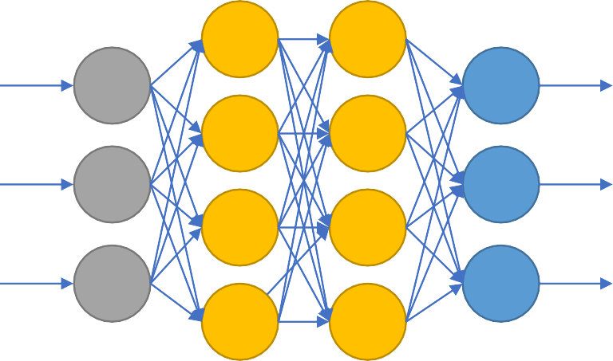
Motivation for Neural Nets
Use biology as inspiration for mathematical model
Get signals from previous neurons
Generate signals (or not) according to inputs
Pass signals on to next neurons
By layering many neurons, can create complex model

Slide 4
Neural Net Structure
Input
(Feature Vector)
Output
(Label)
Can think of it as a complicated computation engine
We will ”train it” using our training data
Then (hopefully) it will give good answers on new data

Slide 5
Basic Neuron Visualization
activation function

Slide 6
Basic Neuron Visualization
Data from previous
layer
activation function

Slide 7
Basic Neuron Visualization
Some form of computation transforms the inputs
activation function

Slide 8
Basic Neuron Visualization
The neuron outputs the transformed data
activation function

Slide 9
Basic Neuron Visualization
x₁
w₁
activation function
w₂
x₂
w₃
x₃

Slide 10
Basic Neuron Visualization
x₁
w₁
activation function
w₂
x₂
w₃
b
x₃
1

Slide 11
Basic Neuron Visualization
x₁
w₁
z = x₁w₁+ x₂w₂+ x₃w₃+b
activation function
f(z)
w₂
x₂
w₃
b
x₃
1

Slide 12
In Vector Notation
z = “net input” b = “bias term”
f = activation function a = output to next layer
𝑚
𝑧 = 𝑏 + ෍ 𝑥_{𝑖}𝑤_{𝑖}
𝑖=1
𝑧 = 𝑏 + 𝑥^{𝑇}𝑤
𝑎 = 𝑓(𝑧)

Slide 13
Relation to Logistic Regression
When we choose: 𝑓 𝑧 =
1
1+𝑒^{−𝑧}
𝑚
𝑧 = 𝑏 + ෍ 𝑥_{𝑖}𝑤_{𝑖} = 𝑥₁𝑤₁ + 𝑥₂𝑤₂ + ⋯ + 𝑥_{𝑚}𝑤_{𝑚} + 𝑏
𝑖=1
Then a neuron is simply a ”unit” of logistic regression!
weights ⬄ coefficients inputs ⬄ variables bias term ⬄ constant term

Slide 14
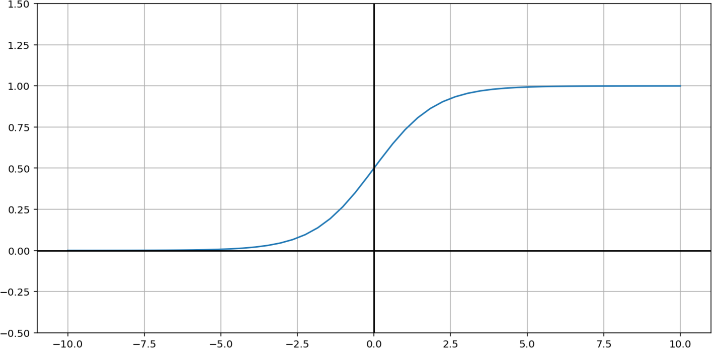
Relation to Logistic Regression
This is called the “sigmoid” function:
𝜎 𝑧 =
1
1+𝑒^{−𝑧}

Slide 15
Nice Property of Sigmoid Function
1
𝜎 𝑧 =
𝜎′ 𝑧 =
Quotient rule
′
1 + 𝑒^{−𝑧}
0 − (−𝑒^{−𝑧})
_{𝑒}−𝑧
𝑑 𝑓(𝑥) 𝑓 𝑥 𝑔 𝑥 − 𝑓 𝑥 𝑔′(𝑥)
⋅ =
=
1 + 𝑒^{−𝑧}
1 + 𝑒^{−𝑧}
𝑑𝑥 𝑔(𝑥)
𝑔 𝑥
2
1 + 𝑒^{−𝑧}
2
2
1 + 𝑒^{−𝑧} − 1
1
=
=
₂ −
1 + 𝑒^{−𝑧}
1
2
1 + 𝑒^{−𝑧}
1 + 𝑒^{−𝑧}
2
1
1
=
1 + 𝑒^{−𝑧}
1
1 −
1 + 𝑒^{−𝑧}
= −
1 + 𝑒^{−𝑧} 1 + 𝑒^{−𝑧}
2
𝜎′ 𝑧
= 𝜎(𝑧)(1 − 𝜎(𝑧))
This will be helpful!

Slide 16
Example Neuron Computation
x₁
w₁
z = x₁w₁+ x₂w₂+ x₃w₃+b
(sigmoid) activation
function
f(z)
w₂
x
2
w₃
b
x₃
1

Slide 17
Example Neuron Computation
.9
2
z = x₁w₁+ x₂w₂+ x₃w₃+b
(sigmoid) activation
function
f(z)
3
.2
-1
.5
.3
1

Slide 18
Example Neuron Computation
.9
2
z = .9(2)+ .2(3)+ .3(-1)+.5 = 2.6
(sigmoid) activation
function
f(z)
3
.2
-1
.5
.3
1
18

Slide 19
Example Neuron Computation
.9
2
z = .9(2)+ .2(3)+ .3(-1)+.5 = 2.6
(sigmoid) activation
function
f(z)=f(3.5)=1/(1+exp(-2.6))
= .93
3
.2
-1
.5
.3
1

Slide 20
Example Neuron Computation
.9
2
z = .9(2)+ .2(3)+ .3(-1)+.5 = 2.6
(sigmoid) activation
function
f(z)=f(3.5)=1/(1+exp(-2.6))
= .93
3
.2
-1
Neuron would output the value .93
.5
.3
1

Slide 21
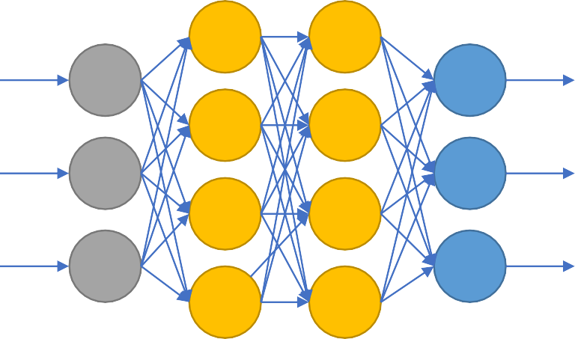
Why Neural Nets?
Why not just use a single neuron? Why do we need a larger network?
A single neuron (like logistic regression) only permits a linear decision boundary.
Most real-world problems are considerably more complicated!
34

Slide 22
Feedforward Neural Network
𝜎 𝜎
𝑥₁
𝑦ො₁
𝜎
𝜎
𝑥₂
𝑦ො₂
𝜎
𝜎
𝑥₃
𝑦ො₃
𝜎
𝜎
34

Slide 23
Weights
𝜎
𝜎
𝑥₁
𝑦ො₁
𝜎
𝜎
𝑥₂
𝑦ො₂
𝜎
𝜎
𝑥₃
𝑦ො₃
𝜎
𝜎
34

Slide 24
Input Layer
𝜎
𝜎
𝑥₁
𝑦ො₁
𝜎
𝜎
𝑥₂
𝑦ො₂
𝜎
𝜎
𝑥₃
𝑦ො₃
𝜎
𝜎
34

Slide 25
Hidden Layers
𝜎
𝜎
𝑥₁
𝑦ො₁
𝜎
𝜎
𝑥₂
𝑦ො₂
𝜎
𝜎
𝑥₃
𝑦ො₃
𝜎
𝜎
34

Slide 26
Output Layer
𝜎
𝜎
𝑥₁
𝑦ො₁
𝜎
𝜎
𝑥₂
𝑦ො₂
𝜎
𝜎
𝑥₃
𝑦ො₃
𝜎
𝜎
34

Slide 27
Weights (represented by matrices)
_{𝑊}(1) _{𝑊}(2) _{𝑊}(3)
𝜎 𝜎
𝑥₁
𝑦ො₁
𝜎
𝜎
𝑥₂
𝑦ො₂
𝜎
𝜎
𝑥₃
𝑦ො₃
𝜎
𝜎
34

Slide 28
Net Input (sum of weighted inputs, before activation function)
_{𝑧}(2) _{𝑧}(3)
_{𝑧}(4)
𝜎 𝜎
𝑥₁
𝑦ො₁
𝜎
𝜎
𝑥₂
𝑦ො₂
𝜎
𝜎
𝑥₃
𝑦ො₃
𝜎
𝜎
34

Slide 29
Activations (output of neurons to next layer)
_{𝑎}(2) _{𝑎}(3)
_{𝑎}(1)
_{𝑎}(4)
𝜎 𝜎
𝑥₁
𝑦ො₁
𝜎
𝜎
𝑥₂
𝑦ො₂
𝜎
𝜎
𝑥₃
𝑦ො₃
𝜎
𝜎
34

Slide 30
Matrix representation of computation
_{𝑧}(2)
_{𝑊}(1)
_{𝑎}(2)
𝜎
𝑥₁
𝑥
𝑊⁽¹⁾ is a 3x4 matrix
𝑧⁽²⁾ is a
4-vector
𝑎⁽²⁾ is a
4-vector
𝜎
(𝑥 = 𝑎⁽¹⁾)
_{𝑧}(2) _{= 𝑥𝑊}(1)
𝑎⁽²⁾ = 𝜎(𝑧 ² )
𝑥
2
𝜎
𝑥₃
𝜎
34

Slide 31
Continuing the Computation
For a single training instance (data point) Input: vector x (a row vector of length 3)
Output: vector 𝑦ො (a row vector of length 3)
_{𝑧}(2) _{= 𝑥𝑊}(1)
_{𝑧}(3) _{= 𝑎}(2)_{𝑊}(2)
_{𝑧}(4) _{= 𝑎}(3)_{𝑊}(3)
𝑎⁽²⁾ = 𝜎(𝑧 ² )
𝑎⁽³⁾ = 𝜎(𝑧 ³ )
𝑦ො = 𝑠𝑜𝑓𝑡𝑚𝑎𝑥(𝑧 ⁴ )
34

Slide 32
Multiple data points
In practice, we do these computation for many data points at the same time, by “stacking” the rows into a matrix.
But the equations look the same!
Input: matrix x (an nx3 matrix) (each row a single instance)
Output: vector 𝑦ො (an nx3 matrix) (each row a single prediction)
_{𝑧}(2) _{= 𝑥𝑊}(1)
_{𝑧}(3) _{= 𝑎}(2)_{𝑊}(2)
_{𝑧}(4) _{= 𝑎}(3)_{𝑊}(3)
𝑎⁽²⁾ = 𝜎(𝑧 ² )
𝑎⁽³⁾ = 𝜎(𝑧 ³ )
𝑦ො = 𝑠𝑜𝑓𝑡𝑚𝑎𝑥(𝑧 ⁴ )
34

Slide 33
Now we know how feedforward NNs do Computations.
Next, we will learn how to adjust the weights to learn from data.
34

Slide 34
34

